Slide 1


Medicine stock and prescription assessment
Preliminary findings
June to August 2026

Slide 2
Background and study objectives
Background
Objectives: Quantify availability and the volume, causes, and cost of unserved prescriptions, and locate each gap in the supply chain
QMIA. MoH, RMS and RSSB merged their planned assessments into one QMIA-linked survey to avoid duplication
One aligned assessment. RMS and RSSB had planned separate prescription assessments; merging them with QMIA avoids duplication and links the evidence.
The gap. Unserved prescriptions send patients to private or home untreated, yet they are not measured nationally.
.
1
5
Medicine availability on the visit day, by level of care, province, and district
Whether each unserved medicine was at RMS regional or central stores
2
Stock record accuracy: physical count against the facility's digital tool
6
Whether the facility requested the missing medicine, and if it was supplied fully, partly, or not at all
3
Stock-out frequency and duration over the preceding three months
7
Financial value of unserved prescriptions at official tariff prices
4
8
Availability at community level through each facility's community health worker
Share and quantity of unserved prescriptions

Slide 3
Methods
266
175
30
6,006*
55
205 HCs + 25HPs+24DHs+10 L2TH+2Nat. Referral
community health workers
districts
every level of care
Prescriptions
Products assessed
Sampling
Prescriptions and medicines
Data sources and team
Multistage stratified cluster design. The Yamane formula on 583 facilities (95% confidence, 5% margin of error) gives 237, allocated proportionally by level of care, province, and district and drawn at random by computer. A total of 25 Health posts were added to the sample
20 to 30 prescriptions per facility, scaled to level of care: 10 from the visit day and the rest from the preceding 10 days. A 55 list of medicines based on the country's top diagnoses covers essential medicines and program commodities.
Facility counts, stock cards, dispensing logs, prescription registers, and requisitions; RMS warehouse stock, and deliveries; RSSB claims. Linking them classifies each unserved item as a distribution gap or nationwide stock-out and values it. A total of 27 teams pair central staff (MoH, RMS, RSSB, CHAI) with RMS branch managers over 10 working days
*Prescriptions assessed: 20 at each HCs and 30 at each hospitals for a total of 6006

Slide 4
Findings

Slide 5
Headline results
1. Availability
2. Distribution
3. Stock adequacy
4. Inventory records
93.5%
87.6%
86.4%
23.9%
56.1%
Of medicine available based on managed* products;
Of medicine available based on EML allocation
of medicines missing at the facility were available at RMS Central or Regional
Adequately stocked
46.6% overstocked, 22.2% understocked, and 7.2% stocked out at the day of the survey
Record accuracy
physical count equals the system count; Musanze lowest at 17.5%
5. Stock-outs
6. Prescriptions
7. Orders
8. Community
9.9%
98.8%
93.1%
77.8%
Stock-out incidence over the last three months, affected TB items out 113 days on average
Fully served across facilities. Higher rate of unserved prescriptions at CHUs,32.9% had a missing item
Order fill rate
ARV only 66.2%; and EM with 94.1%
CHW availability
only 36.6% of CHWs held every product they manage

Slide 6
Why medicines were not managed, and which medicines
Reason (coded from free text) | Medicine-facility pairs | Medicines citing it most (pairs)
No demand / no cases / referred |  | RHZ 75/50/150 pediatric (72), ethambutol 100 mg (61), insulin human (56)
MFT zoning: other antimalarial in zone |  | Pyronaridine/artesunate (102), DHAP (91), artemether-lumefantrine (82)
Rejected by RSSB / cost |  | Beclomethasone inhaler (51), diclofenac suppository (48), gliclazide 60 mg (28)
Uses an alternative product |  | Polyglactin 910 suture (50), chromic catgut (15), heat-stable carbetocin (11)
Believed not allowed at this level |  | Caffeine citrate inj. (31), heat-stable carbetocin (21), tranexamic acid inj. (12)
Faith-based: no modern FP by policy |  | DMPA 150 mg (29), copper IUD (29), levonorgestrel implant (28)
New product not yet introduced or trained |  | Tranexamic acid inj. (21), heat-stable carbetocin (18), gliclazide 60 mg (11)
Reported not available / not supplied |  | Heat-stable carbetocin (10), tranexamic acid inj. (8), polyglactin 910 (7)
Holds another strength |  | Gliclazide 60 mg (14), ciprofloxacin 500 mg (6), amlodipine (5)
Not on facility formulary |  | Heat-stable carbetocin (4), polyglactin 910 (2), tranexamic acid inj. (2)
Service not offered here |  | Gliclazide 60 mg (5), beclomethasone (4), amlodipine (3)
335
300
150
147
130
114
101
74
39
38
35

Slide 7
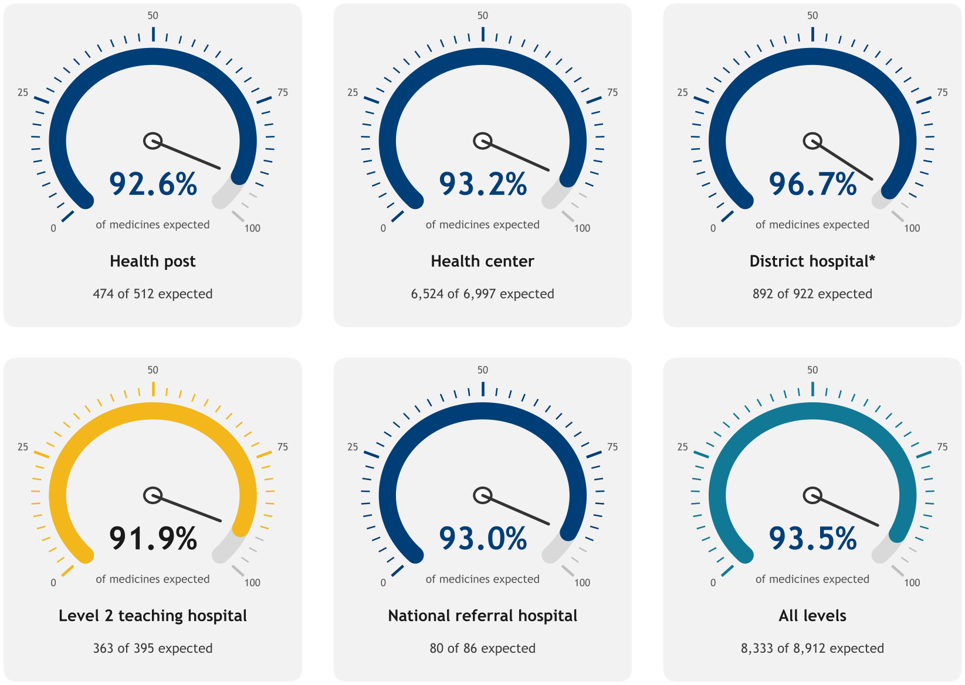
Medicines availability
Availability by level of care (managed products)
93.5% of managed medicines were available on the day of the visit; 87.6% when every expected medicine as per EML is counted
Two denominators. Counting only products each facility manages gives 93.5% of 8,912 pairs; counting every EML-authorized medicine gives 87.6% of 9,508. The 5.9-point gap is medicines facilities are authorized for but do not stock.
By level. District hospitals are highest (96.7%) and level 2 teaching hospitals lowest (91.9%). Health centers hold 79% of all observations, so their 93.2% sets the national figure.
By management. Faith-based 94.5%, government 93.2%, and PPP 92.1%; within every group.
Notes:
Available on the visit day / managed pairs, by level of care. Gold: lowest level; turquoise: all levels.

Slide 8
Medicines availability by program
Availability by program (managed products)
ARV products were the least available program (90.6%); malaria commodities the most (98.3%)
ARV gap is a supply gap. HIV Determine test kits drive it ,with the most reported stock-out (32 facilities, 13 districts).
Health posts struggle with ARV and MCCH. ARV availability at health posts is 54% and MCCH 89%.
FP is weakest in the West (85%) and ARV in Kigali City and North (86% each), against 90.6% to 91.8% nationally.
Notes:
Available on the visit day / managed pairs by medicine_program.
ARV 884, FP 841, TB 727, EM 4,373, MCCH 691, Consumables 810, Malaria 585.

Slide 9
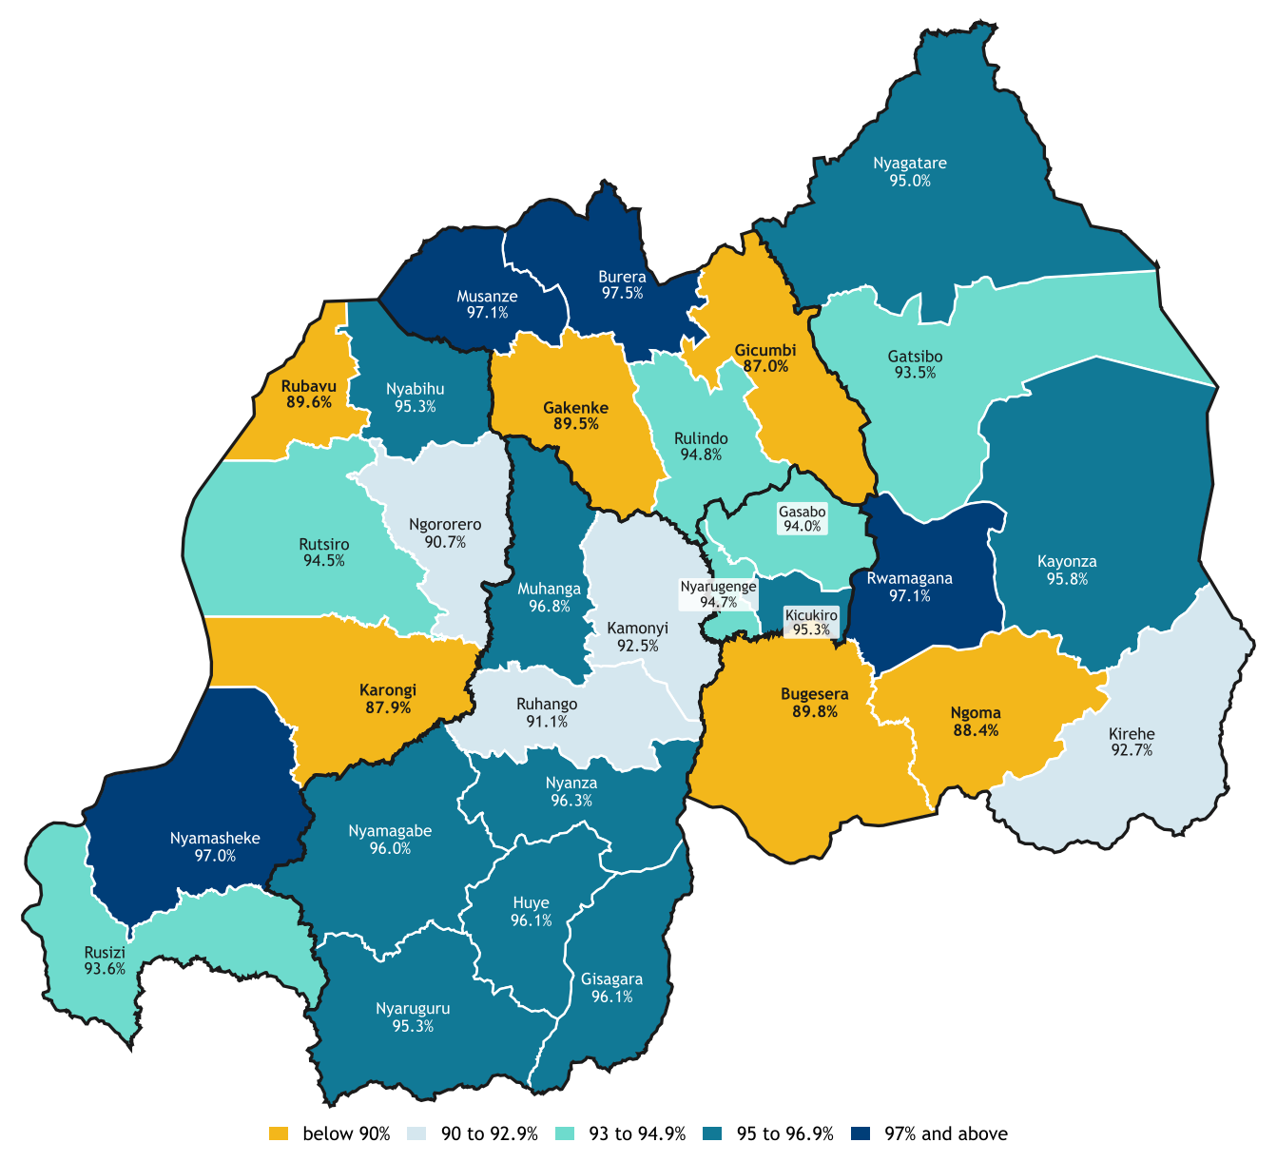
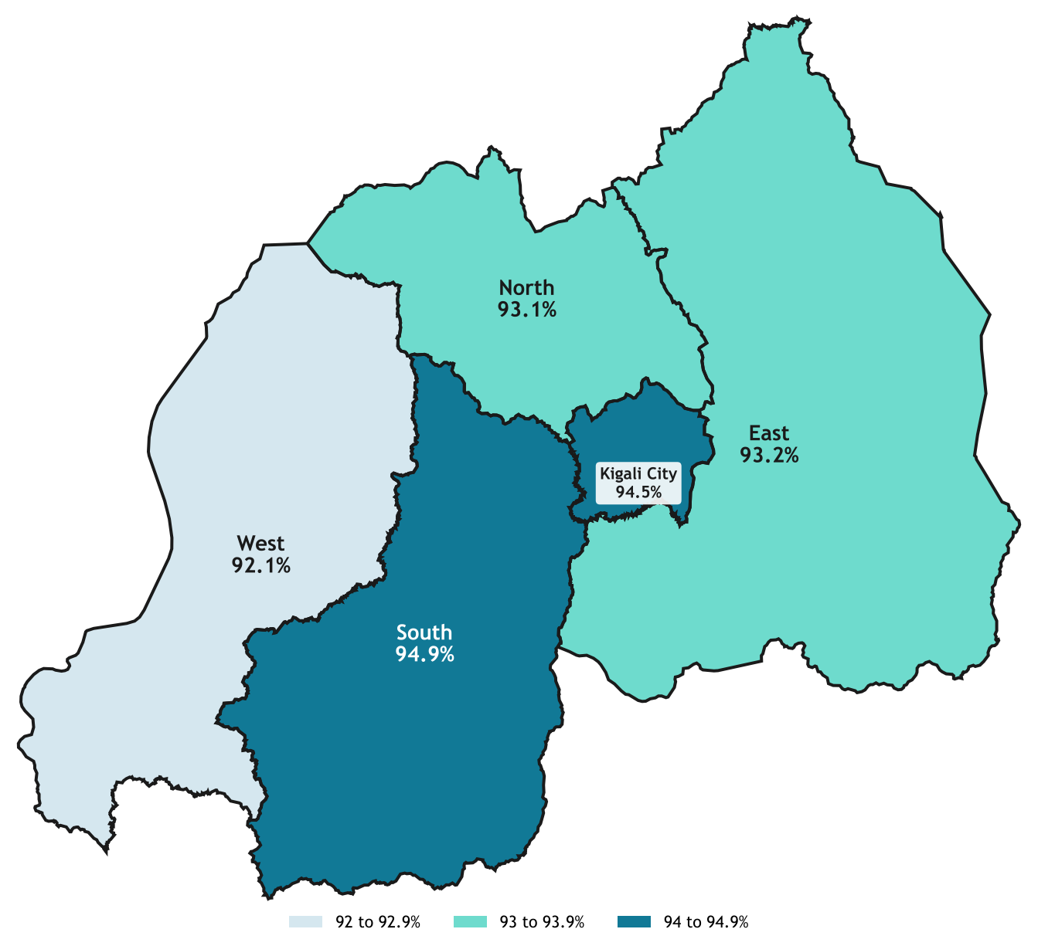
Medicines availability
Pooled availability by district (managed products)
Pooled availability by province (managed products)
. Boundaries: geoBoundaries ADM2 (NISR), CC BY 4.0.
Gicumbi, Karongi, Ngoma, Gakenke, Rubavu, and Bugesera fall below 90%; Burera and Musanze lead.
South and Kigali City lead (94.9%, 94.5%); West is lowest at 92.1%.
Notes:
Managed products, pooled by province; national 93.5%.
Managed products, pooled by district

Slide 10
Medicines availability
By level of care
By province
 | HP n=512 | HC n=6,996 | DH n=922 | L2TH n=395 | NRH n=86 | All n=8,911
ARV n=884 | 54% n=13 | 91% | 96% | 89% | 100% n=8 | 91%
FP n=841 | 92% | 92% | 97% | 79% | 100% n=4 | 92%
TB n=727 | – | 92% | 97% | 95% | 33% n=6 | 92%
Essential Med. n=4,373 | 93% | 93% | 95% | 94% | 96% | 93%
MCCH n=691 | 89% n=27 | 95% | 99% | 86% | 100% n=9 | 95%
Consumables n=810 | 93% | 95% | 100% | 97% | 100% n=4 | 96%
Malaria n=884 | 100% | 98% | 100% | 100% n=24 | 100% n=2 | 98%
 | Kigali | North | South | East | West | All
ARV | 86% | 86% | 94% | 90% | 93% | 91%
FP | 94% | 94% | 97% | 91% | 85% | 92%
TB | 92% | 86% | 95% | 94% | 92% | 92%
Essential Med. | 96% | 94% | 94% | 92% | 92% | 93%
MCCH | 95% | 93% | 96% | 97% | 93% | 95%
Consumables | 97% | 95% | 94% | 98% | 94% | 96%
Malaria | 96% | 100% | 99% | 99% | 97% | 98%
below 70%
70-79%
80-89%
90-94%
95%+
n < 30
Grey = fewer than 30 pairs. DH includes the provincial hospital; no TB pairs expected at HP (–).
• FP is weakest in the West (85%) and ARV in Kigali City and North (86% each), against 91 to 92% nationally.

Slide 11
Highlighting the least available medicines and low performing facilities
10 least available medicines
10 facilities with lowest availability
Medicine | Prog. | Facilities | Available
Insulin human 100 IU/ml | EM | 98 | 58.2%
RHZ 75/50/150 pediatric | TB | 124 | 77.4%
HIV-1/2 Determine test | ARV | 250 | 78.0%
Thiamine (both strengths) | EM | 252 | 79.4%
Polyglactin 910 suture | Cons. | 63 | 84.1%
Beclomethasone inhaler | EM | 153 | 85.6%
Heat-stable carbetocin | MCCH | 44 | 86.4%
Gliclazide 60 mg | EM | 134 | 87.3%
Ethambutol 100 mg | TB | 141 | 88.7%
ABC/3TC/DTG 60/30/5 mg | ARV | 188 | 88.8%
Facility | District | Level | Available
Mubuga CS | Karongi | HC | 69.0%
Kinazi CS | Ruhango | HC | 70.3%
Busengo CS | Gakenke | HC | 70.6%
Gatuna HP | Gicumbi | HP | 71.4%
Burunga HP | Karongi | HP | 72.0%
Birambo CS | Karongi | HC | 73.2%
Muhororo CS | Ngororero | HC | 73.5%
Rukumberi CS | Ngoma | HC | 77.5%
Kirinda CS | Karongi | HC | 78.0%
Rubaya CS | Gicumbi | HC | 79.4%
Notes:
Insulin is the least available medicine (58%); four of the 10 weakest facilities are in Karongi
Pooled facility rate 93.5%, unweighted mean 93.6% across 266 facilities.

Slide 12
The availability of medicines at RMS vs Facility
Unavailable at the facility: was the stock at RMS?
Distribution gap by program
Missing items were more often in stock at RMS Central than at RMS Regional, by 5 to 16 points (equal at NRH).
.
Notes:
Unavailable rows answered 'Yes' at the store / unavailable rows with a Yes or No answer for both stores. NRH rests on 4 rows
ARVs: just over half of ARV stock-outs were also out at RMS, i.e. a national supply problem rather than a distribution one.

Slide 13
Medicines with most reported stockout
Medicine | Program | Facilities reporting | Districts | Facilities managing it | Share of managing facilities
HIV-1/2 Determine HIV Early Detect (100 tests) | ARV | 32 | 13 | 250 | 12.8%
Insulin human 100 IU/ml, 10 ml (fast-acting) | Essential Medicines | 9 | 7 | 98 | 9.2%
Levonorgestrel implant (Jadelle) | FP | 4 | 4 | 219 | 1.8%
Levonorgestrel/ethinyl estradiol + Fe (Microgynon) | FP | 3 | 3 | 221 | 1.4%
RHZ 75/50/150 (pediatric TB) | TB | 3 | 2 | 124 | 2.4%
Thiamine 100 mg tablet | Essential Medicines | 3 | 3 | 155 | 1.9%
Atazanavir/ritonavir 300/100 mg | ARV | 2 | 2 | 214 | 0.9%
Vitamin C 500 mg tablet | Essential Medicines | 2 | 2 | 259 | 0.8%
Vitamin B1 (thiamine) 50 mg tablet | Essential Medicines | 2 | 2 | 147 | 1.4%
Notes:
Nationwide stock-out: not on the facility shelf and not available at RMS Central. 68 rows in total; eight further medicines were reported by a single facility each (amlodipine/losartan/HCTZ, amoxicillin/clavulanate inj., beclomethasone, ciprofloxacin, chromic catgut, IUD, metronidazole, MgSO4).

Slide 14
Stock adequacy
Stocked out
no stock on the visit day
Only 24% of medicines sat in the 1-2 month target band; nearly half were overstocked
Overstock is the dominant problem. 3,960 medicines (46.6%) held more than two months of stock.
Understock is urgent where it occurs. 1,889 medicines (22.2%) held under one month; 928 of these (49%) were at or below 0.5 months, the emergency order point.
7.2% were stocked out on the visit day (615 medicines with no stock to dispense).
615
Understock
under one month of stock
928 (49%) at or below 0.5 months: emergency order point
1,889
Adequate
one to two months, the target band
2,034
Overstock
more than two months; capital tied up, expiry risk
3,960
Notes:
Months of stock = stock on hand / AMC (June-August). Base: stocked-out rows + in-stock rows with consumption > 0. At CHUK and CHUB, 1-3 months = adequate.

Slide 15
Stock adequacy
By level of care
By program
Notes:
Vertical programs are the most overstocked (malaria 77%); consumables the most understocked (36%)
Shares within each group; n in brackets. Labels under 6% hidden.
Vertical programs manage their own ordering, so the mix differs sharply between them. Province mix is similar (overstock 42-50%).

Slide 16
Stock adequacy
Most often understocked
Most often overstocked (share of stocked rows)
Notes:
Under one month of stock, among rows on the shelf with consumption > 0; medicines with 30+ stocked rows.
More than two months (three at CHUK/CHUB). Median months of stock reaches 10.2 for pyronaridine/artesunate 180/60 and 9.0 for AL 4x6.

Slide 17
Stock accuracy (digital matched the physical records)
Inventory record accuracy by level of care
Exact match 56.1% (4,967 of 8,856 records); average quantity accuracy 69.8%.
Lower levels drive the gap. Health posts match on 38% of records and health centers on 52%, against 85% or more in district and referral hospitals.
Consistent across programs (51-61% exact match), so this is a record-keeping practice issue
By province: West 66.8% best, Kigali City 42.0% worst.
Notes:
Exact match: physical count = system count. Quantity accuracy: mean of max(0, 1 - |system - physical| / system), 0% where system = 0 (100% when the physical count is 0 too). Records naming a digital system only.

Slide 18
Average monthly consumption
Total AMC across facilities (units per month)
Gloves, paracetamol, and ibuprofen dominate monthly consumption
Gloves lead at 2.48M units a month across 264 facilities (mean 9,378, median 2,450).
Consumption is heavily skewed. Means sit well above medians (omeprazole: mean 1,857 vs median 600), so a few large facilities drive totals; plan on medians and facility-level AMC.
Notes:
AMC = sum of the three monthly quantities / months with a value; matches the form's own field on all 9,851 complete rows.

Slide 19
Stock-out incidence
Incidence by program
Incidence by level of care
Essential Medicines
602 of 4,814
ARV
100 of 884
8.1%
10.5%
5.6%
12.5%
with a stock-out
with a stock-out
with a stock-out
Health post
Health center
District hospital*
11.3%
FP
66 of 841
45 of 555 pairs
791 of 7,541 pairs
57 of 1,025 pairs
7.8%
9.9%
952 of 9,652
managed pairs
TB
57 of 727
7.8%
Pairs with at least one stock-out day
7.2%
MCCH
50 of 691
10.6%
14.0%
5.8%
with a stock-out
with a stock-out
No stock-out in the period
Malaria
30 of 884 · 3.4%
Consumables
47 of 810
Level 2 teaching hospital
National referral hospital
All levels: 9.9%
952 of 9,652 pairs
47 of 445 pairs
12 of 86 pairs
Notes:
One in 10 managed medicines stocked out at least once in June-August; 220 of 266 facilities were affected
Managed pairs with at least one stock-out day June-August / all managed pairs. Wedge length is relative to the highest program; red = above the 9.9% overall rate.
*District hospital includes the one provincial hospital (55/980 + 2/45). 615 pairs were out on the visit day itself. March-May fields are empty, so the window is three months.

Slide 20
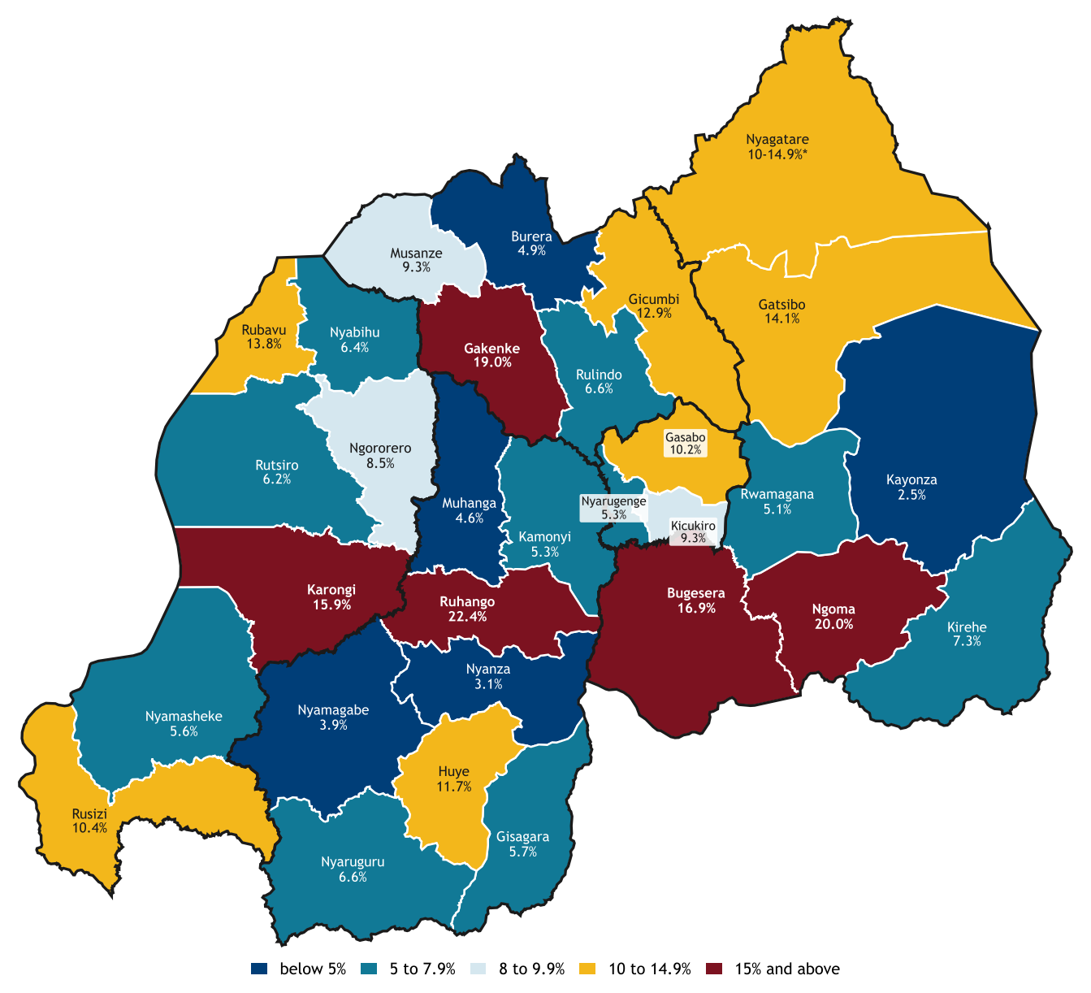
Stock-outs incidence
Stock-out incidence by district (overall 9.9%)
Mean days out per affected pair, by program
Managed pairs with at least one stock-out day June-August / managed pairs, by district. Highest: Ruhango 22.4%, Ngoma 20.0%, Gakenke 19.0%. *Nyagatare value to confirm. Boundaries: geoBoundaries ADM2 (NISR), CC BY 4.0.
Notes:
Stock-outs are rare for program products but long once they occur: 65-113 days on average
Total stock-out days (total_stockout_days), mean over pairs with at least one day out; n affected pairs in brackets.

Slide 21
Thiamine, insulin, HIV test kits, and pediatric TB drugs carry the heaviest stock-out burden
Medicine (30+ managed pairs) | Program | Managed pairs | Incidence (ever out) | Average days out
Vitamin B1 (thiamine) 50 mg | EM | 147 | 46.3% | 112.0
Thiamine 100 mg | EM | 155 | 38.7% | 93.7
Insulin human 100 IU/ml | EM | 98 | 34.7% | 50.1
HIV-1/2 Determine test | ARV | 250 | 22.8% | 59.4
Beclomethasone inhalation 250 mcg | EM | 153 | 22.2% | 96.1
RHZ 75/50/150 (pediatric) | TB | 124 | 21.0% | 128.6
Diclofenac suppository | EM | 195 | 19.5% | 83.9
Polyglactin 910 suture | Cons. | 63 | 19.0% | 107.1
Amlodipine 5 mg | EM | 191 | 17.8% | 48.3
ABC/3TC/DTG 60/30/5 mg | ARV | 188 | 17.0% | 95.7
Notes:
Incidence: pairs with at least one stock-out day / managed pairs. Days-out rate: total days out / (pairs x 92). Average days out: total_stockout_days per pair with at least one day out. Light blue: 60+ days on average.

Slide 22
Prescription fulfillment
Prescriptions with at least one item unavailable
98.8% of prescriptions were fully available, but one in three at national referral hospitals had a gap
5,934 of 6,006 prescriptions complete; 58 partially served (1.0%) and 14 with nothing available (0.2%). 107 of 14,059 prescribed items (0.8%) were unserved.
Referral hospitals stand out: 23 of 70 NRH prescriptions and 41 of 263 items (15.6%) were unserved; longer, more specialized lists create more gaps.
%.
Notes:
The prescribers tend to write what the pharmacy holds, so this understates true unmet need. Use the stock pages for availability
Levels with fewer than 30 prescriptions left out (the provincial hospital is counted with district hospitals). By management model: government 1.4%, faith-based 1.2%, and PPP 0.2

Slide 23
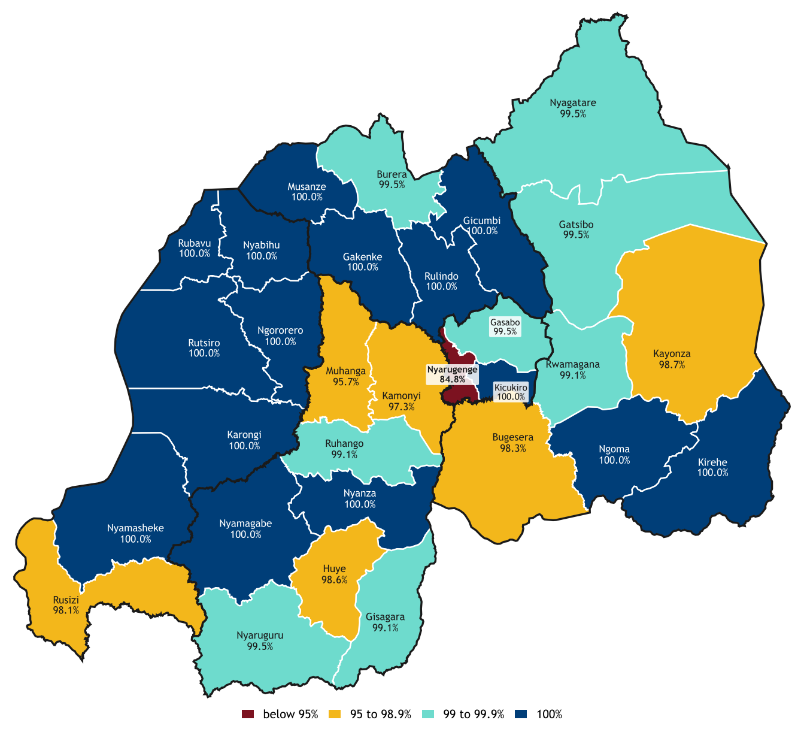
Unserved prescriptions cluster in Nyarugenge (84.8% complete) and in diabetes and respiratory medicines
Prescriptions complete, by district
Unserved share of prescribed items, by EML class
geoBoundaries ADM2 (NISR), CC BY 4.0. Province: Kigali City 93.2%, South 98.9%, East 99.3%, West 99.7%, North 99.9%.
Notes:
EML sub-sections prescribed 10+ times; n prescribed items in brackets. Item availability: Nyarugenge 89.9%, Rusizi 97.9%.

Slide 24
Requisition and order fulfillment
Order fill rate by program (quantity delivered / requested)
Order fill rate overall
of requested quantity delivered, June-August
93.1%
0%
100%
35.4M of 38.1M units delivered June-August; monthly fill rate 92.6%(June), 92.0%(July), 94.7%(Aug)
ARV and FP lag: 66.2% and 76.6%. By class, laboratory diagnostics (68.2%), contraceptives (76.6%), and vitamins (77.2%) fill worst.
Faith-based facilities fill best (95.3%) vs government 92.2% and PPP 92.4%.

Slide 25
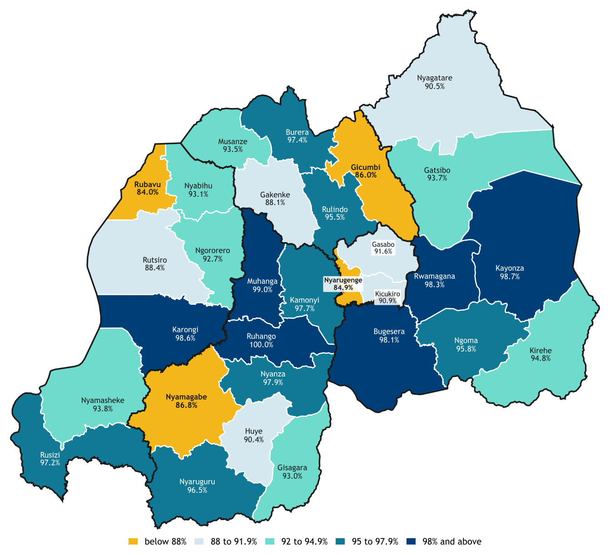
Geographical distribution of order fill rate
Order fill rate by district
Order fill rate by level of care and month
Fill rates fall below 88% in Rubavu, Nyarugenge, Gicumbi, and Nyamagabe.
Province: East 95.6%, South 94.9%, West 92.1%, North 91.8%, Kigali City 87.7%. geoBoundaries ADM2 (NISR), CC BY 4.0.
Notes:
National referral hospitals fell to 20% in July and 35% in August.
Delivered / requested per month, medicine-months where requested >= delivered. *Includes the provincial hospital.

Slide 26
Requisition and order fulfillment
Fill rate by drug class against the national 93.1%
Each pair's own ratio to consumption
Notes:
Quantities pooled over kept medicine-months. National referral hospitals: 248% requested / 194% delivered (not shown).
Pooled ratios near 100% hide offsetting errors: half of pairs request under 90% or over 150% of what they use.

Slide 27
Community-level medicine availability
CHW availability by province (products managed)
918 of 1,180 managed products available across 175 CHWs; 262 stocked out.
Complete basket: 64 of 175 CHWs (36.6%); 36 were missing exactly one product and 38 were missing three or more.
Least available: DHAP (61-66%), ORS (69.8%), zinc (72.2%), and amoxicillin 125 mg (73.8%); malaria RDTs are best at 94.3%.
North lags (65.9%) while West reaches 92.4%.
Denominator excludes 808 'not managed' rows (about 40%), mostly MFT zoning, which is policy rather than stock-out.

Slide 28
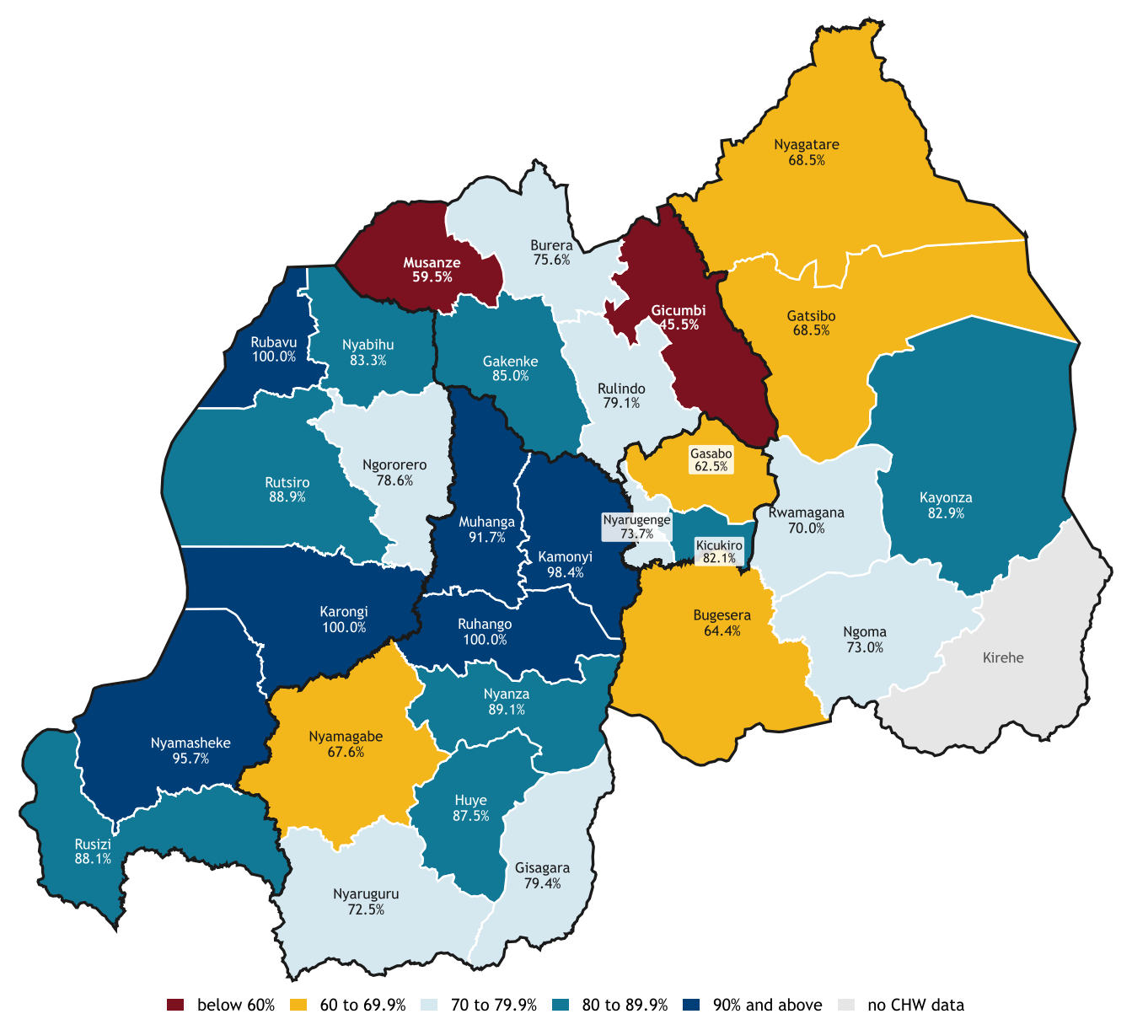
Community-level medicine availability
CHW availability by district
Same product, CHW vs facility availability
geoBoundaries ADM2 (NISR), CC BY 4.0. 29 districts with CHW data; Gicumbi 45.5% (8 CHWs), Musanze 59.5%.
CHW availability trails facilities by 16 points on shared products, and falls below 60% in Gicumbi and Musanze
Only eight of 13 CHW items have a facility comparator; ORS, zinc, and amoxicillin 125 mg are CHW-only. DHAP gap ~30 points.

Slide 29
Feedback to MOH,RSSB and RMS
System level (MoH, RSSB, RMS)
Facility level
Issue
What we ask
11 eBuzima stock does not match shelves or prescriptions
Ask: routine stock reconciliation
15
Unreimbursed items not stocked
e.g. diclofenac suppository
RSSB & RMS: align reimbursement list and prices; joint invoice checks
13
Paper and eBuzima run side by side
Most Health posts still on paper
MoH: offline eBuzima module; link KWIVUZA / RSSB billing
Refresher training
10
Late or partial deliveries
RMS & partners: deliver on time and all requested quantities
6 Dosing and rational use
Paracetamol overdose risk, child formulations, tapering, polypharmacy, dental under-dosing
2 eBuzima use
Staff have the system but do not use it fully
Ask: MoH to schedule refresher sessions
9
Shortages are somewhat hidden
Prescribers write only what is in stock
MoH: emphasize on HFs to record those in the system
2
Referral delays
Ambulance delays at border health posts; nurses leave duty to escort leaving stock work unattended
MoH & districts: review ambulance cover for border health posts

Slide 30
Implications for discussion
About 86% of facility stock-outs had stock at RMS. Tighten RMS-to-facility replenishment and the emergency-order route (928 items at or below 0.5 months).
HIV Determine kits, insulin, thiamine, and pediatric RHZ were out at RMS too; ARVs are half national stock-outs. Escalate with programs and central procurement.
56% exact match overall, 38% at health posts and under 30% in six districts. Prioritize reconciliation and supervision there.
77.8% community level medicine availability and 36.6% complete baskets
NRH: 32.9% of prescriptions with a gap, 20-35% order fill in July-August
47% of stock is overstocked and only 14% of requests match use.
Please find the dashboard of the detailed analysis

Slide 31
Thank you!

